Slide 1
MICROCONTROLLERS
20XC32
MICRO CONTROLLERS AND EMBEDDED SYSTEMS

Slide 2
MICROCONTROLLERS
Microcontrollers and embedded processors
Overview of the 8051 family

Slide 3
Microcontroller vs. General-Purpose Microprocessor
Microcontrollers and Embedded processors
General-purpose microprocessors contains
No RAM
No ROM
No I/O ports
 Microcontroller has
CPU (microprocessor)
RAM
ROM
I/O ports
Timer
ADC and other peripherals

Slide 4
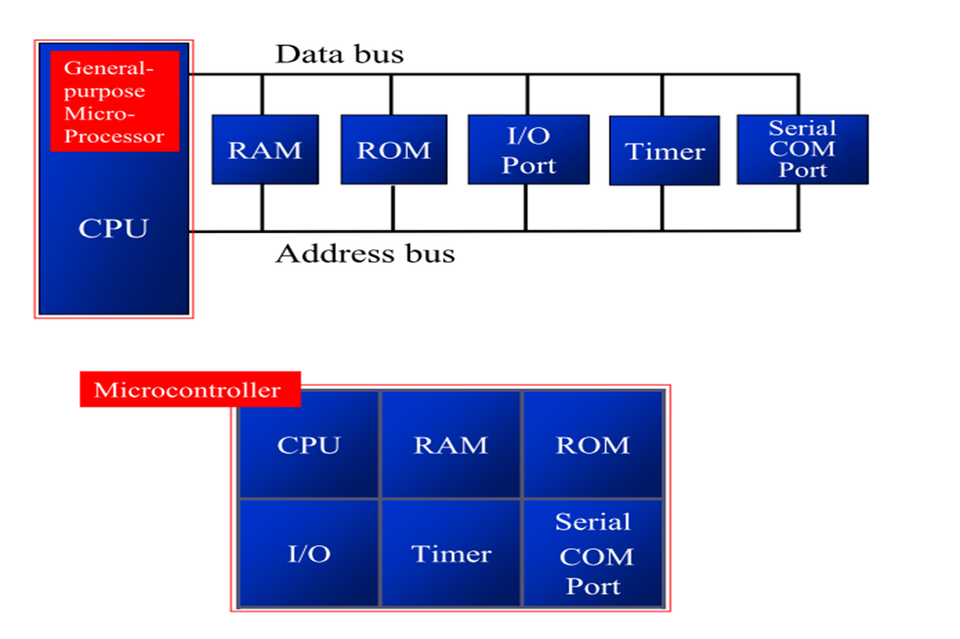
Microcontrollers and embedded processors
Microcontroller vs. General-Purpose Microprocessor

Slide 5
Microcontrollers and embedded processors
General-purpose microprocessors
Must add RAM, ROM, I/O ports, and timers externally to make them functional
Make the system bulkier and much more expensive
Have the advantage of versatility on the amount of RAM, ROM, and I/O ports
Microcontroller
The fixed amount of on-chip ROM, RAM, and number of I/O ports makes them ideal for many applications in which cost and space are critical
In many applications, the space it takes, the power it consumes, and the price per unit are much more critical considerations than the computing power

Slide 6
PC Vs Embedded systems
An embedded product uses a microprocessor (or microcontroller) to do one task and one task only
There is only one application software that is typically burned into ROM
A PC, in contrast with the embedded system, can be used for any number of applications
It has RAM memory and an operating system that loads a variety of applications into RAM and lets the CPU run them
A PC contains or is connected to various embedded products
Each peripheral has a microcontroller inside it that performs only one task

Slide 7
PC Vs Embedded systems
Home
Appliances, intercom, telephones, security systems, garage door openers, answering machines, fax machines, home computers, TVs, cable TV tuner, VCR,, remote controls, video games, cellular phones, musical instruments, sewing machines, lighting control, paging, camera, pinball machines, toys, exercise equipment
Office
Telephones, computers, security systems, fax machines, microwave, copier, laser printer, color printer, paging
Automatives
Trip Counter, engine control, air bag, ABS,instrumentation, security system, transmission control, entertainment, climate control, Bluetooth panels, keyless operations

Slide 8
PC Vs Embedded systems
One of the most critical needs of an embedded system is to decrease power consumption and space
In high-performance embedded processors, the trend is to integrate more functions on the CPU chip and let designer decide which features he/she wants to use
In many cases using x86 PCs for the high-end embedded applications
Saves money and shortens development time
A vast library of software already written
Windows is a widely used platform

Slide 9
Common Characteristics of a Microcontroller
Microcontrollers may be:
‘Embedded’ inside some other device (often a consumer product) so that they can control the features or actions of the product.
Another name for a microcontroller is therefore an ‘embedded controller’.
Dedicated to one task and run one speciﬁc program. The program is stored in ROM and generally does not change
A low-power device. A battery-operated microcontroller might consume as little as 50 milliwatts.
A microcontroller may take an input from the device it is controlling and controls the device by sending signals to diﬀerent components in the device.
A microcontroller is often small and low cost. The components may be chosen to minimize size and to be as inexpensive as possible.

Slide 10
Very often the terms embedded processor and microcontroller are used interchangeably

Slide 11
PC Vs Embedded systems Choosing a Microcontroller
8-bit microcontrollers
Intel’s 8051( year 1981)
Zilog’s Z8
Microchip Technology PIC
Atmel AVR
Texas Instruments MSP430 (16-bit)
Speed and amount of On Chip ROM differs but the instruction set is compatible
There are also 16-bit and 32-bit microcontrollers made by various chip makers

Slide 12
8051 MICROCONTROLLERS
MicroController architecture
Programming
Flashing the code into Microcontroller
Create an Application

Slide 13
8051 family

Slide 14
8051 µC Family
Microcontrollers are classified according to their word length, it ranges from 4 or 8 bits for small systems, 16 bits for medium systems and 32 or 64 bits for high-speed large systems.
The COP400 family from National, and TMS 1000 from Texas Instruments are 4-bit microcontrollers.
8048 family (MCS 48), 8051 family (MCS 51) from Intel, COP 800 family from National, 6805, 6811 from Motorola, PIC16 from Microchip are all 8-bit microcontrollers.
8051XA, 8096 from Intel, 6812 from Motorola are 16-bit microcontrollers.
The Intel 251 family, 683XX, ARM 7, 9, 11 based microcontrollers are 32-bit microcontrollers.

Slide 15
8051 µC
8051 MICRO CONTROLLER

Slide 16
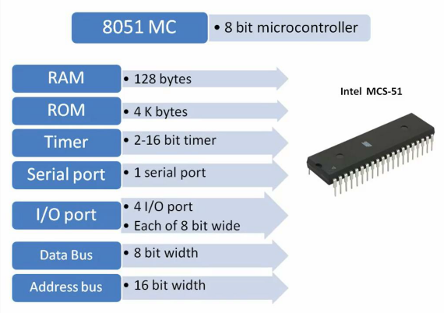
The 8051 is an 8-bit processor
8051 µC

Slide 17
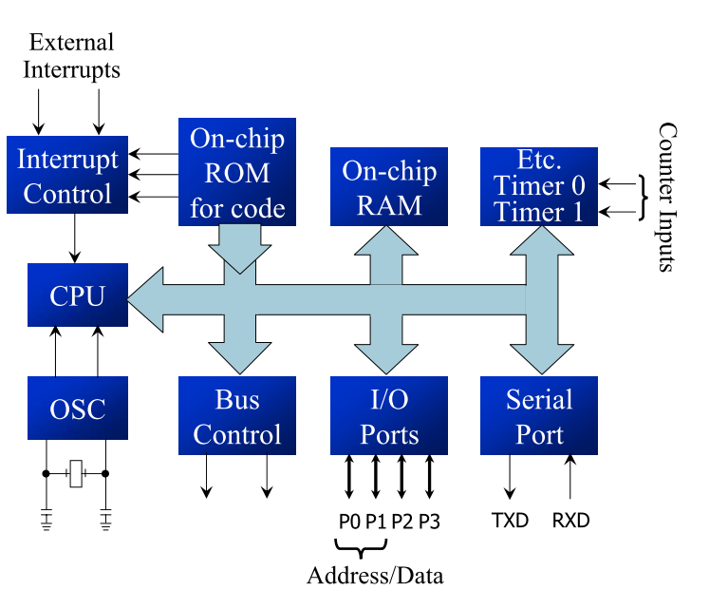
OVERVIEW OF 8051 FAMILY Microcontroller8051
System Bus

Slide 18
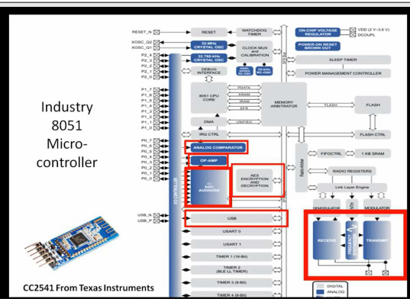
8051 µC Family CC2541 µC from Texas Instrument
Contains advanced features like analogue comparator, op-amp, ADC and USB like facilities.
Even more advanced features like AES and DES encryption system and RF module.

Slide 19
8051 µC
8051 Pin Diagram

Slide 20
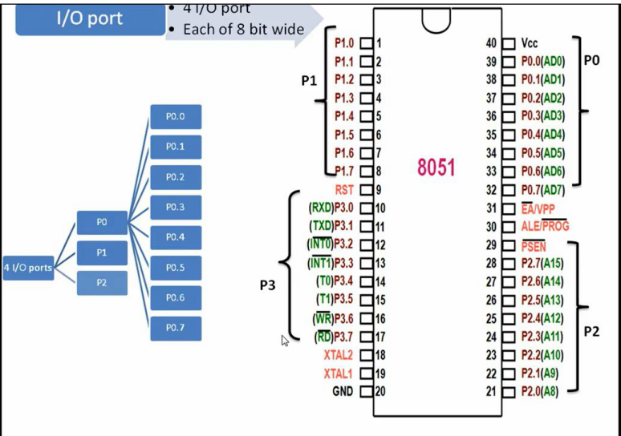
INSIDE THE 8051 PIN DIAGRAM

Slide 21
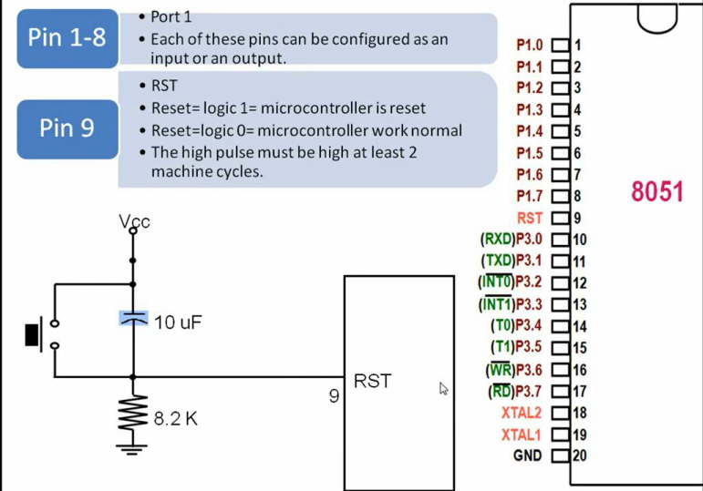
INSIDE THE 8051 PIN DIAGRAM
Port 1 is a bidirectional input-output port
Pin number 9 is a reset pin, this pin is used to reset the microcontroller to its initial value
logic high for at least two machine cycle that is 2.17 us.

Slide 22
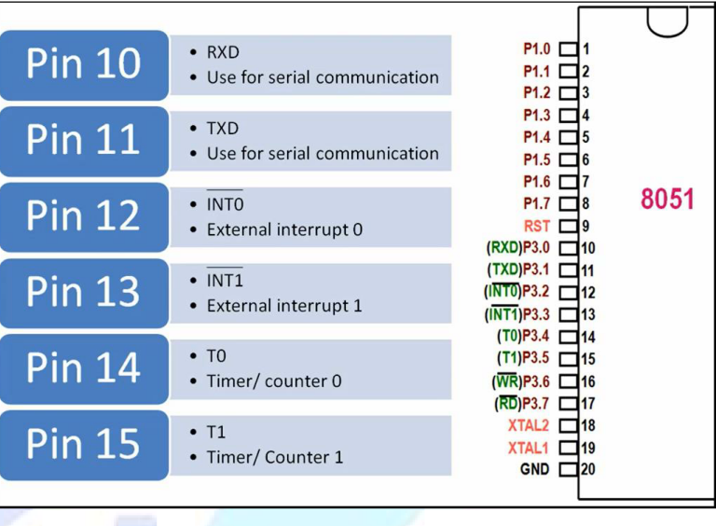
INSIDE THE 8051 PIN DIAGRAM
The external interrupt is given to microcontroller using these 2 pins.
Pin number 14 and 15 are timer 0 and timer 1 pins.
When the timer hardware module of the 8051 microcontroller is configured as a counter, the external event has to be given to these two pins.

Slide 23
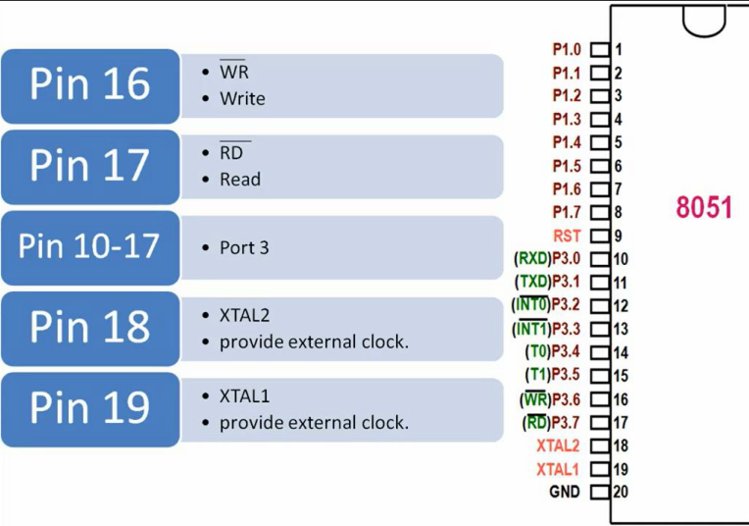
INSIDE THE 8051 PIN DIAGRAM
Both pins 16 and 17 are active low pins used as a control signal for read and write operation when microcontroller communicate with external memory
Pin number 18 and 19 are used to connect external crystal with microcontroller to provide system clock.

Slide 24
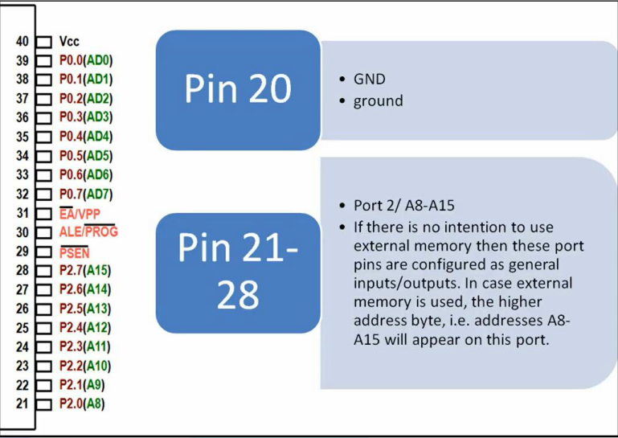
INSIDE THE 8051 PIN DIAGRAM

Slide 25
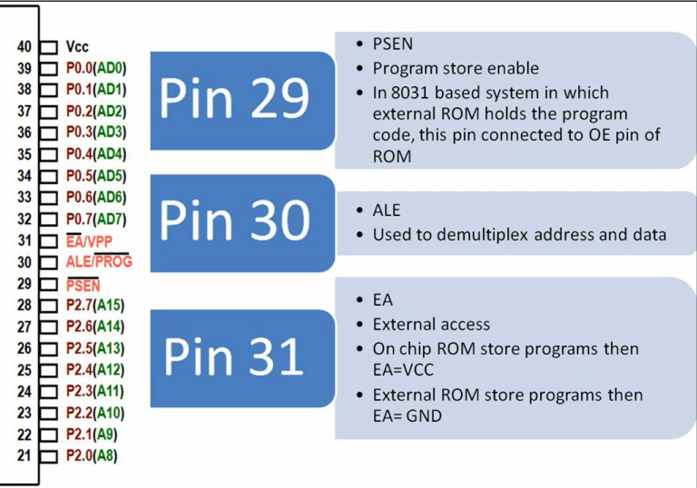
INSIDE THE 8051 PIN DIAGRAM

Slide 26
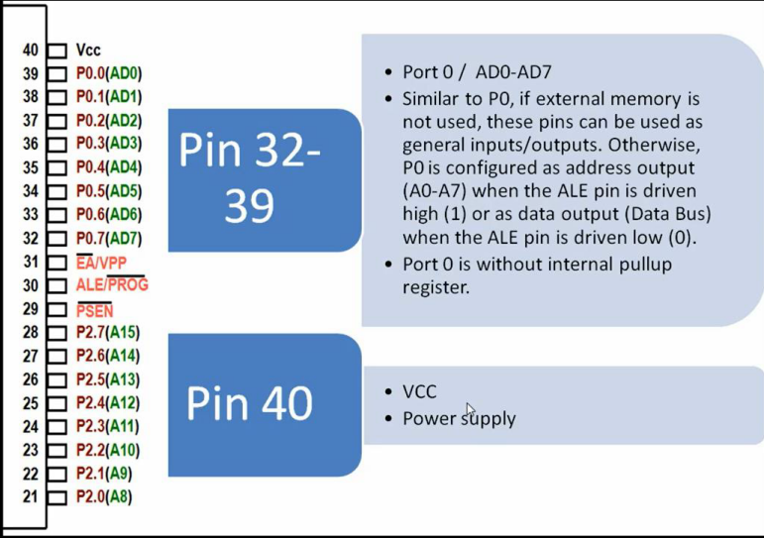
INSIDE THE 8051 PIN DIAGRAM

Slide 27
8051 µC
8051 REGISTERS and Memory Space

Slide 28
INSIDE THE 8051 Registers
Register are used to store information temporarily, while the information could be
a byte of data to be processed, or
an address pointing to the data to be fetched
The vast majority of 8051 register are 8-bit registers
There is only one data type, 8 bits
With an 8-bit data type, any data larger than 8 bits must be broken into 8-bit chunks before it is processed
The data types can be positive or negative

Slide 29
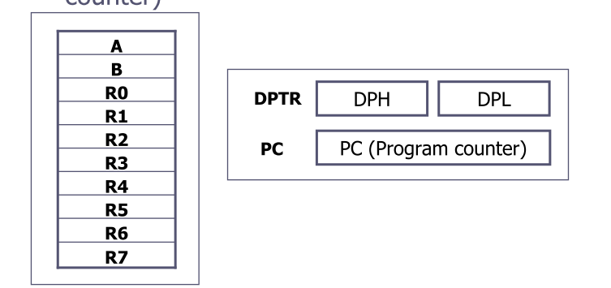

INSIDE THE 8051 Registers
The most widely used registers
A (Accumulator)
 For all arithmetic and logic instructions
B, R0, R1, R2, R3, R4, R5, R6, R7
DPTR (data pointer), and PC (program counter)

Slide 30
INSIDE THE 8051 Memory
8051 memory
ROM 4K byte (min)
RAM 128 bytes

Slide 31
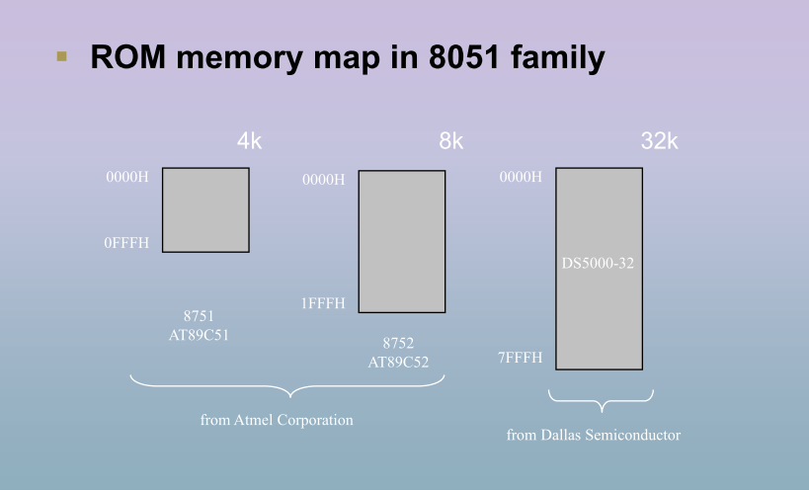
Memory mapping in 8051

Slide 32

INSIDE THE 8051 Memory space ( ROM)
PC and ROM Space inside 8051
Where does the Microcontroller wake up when it is powered on?
Applying Vcc to the RESET Pin
Wakes up at 0000H or starts at address 0000H
PC is loaded with 0000H
i.e., 8051 expects the first opcode to be stored at 0000h
How to achieve? Using ORG directive

Slide 33
REGISTER BANKS AND STACK RAM Memory Space Allocation
There are 128 bytes of RAM in the 8051
Assigned addresses 00 to 7FH
The 128 bytes are divided into three different groups as follows:
A total of 32 bytes from locations 00 to 1F hex are set aside for register banks and the stack
2) A total of 16 bytes from locations 20H to 2FH are set aside for bit-addressable read/write memory
3) A total of 80 bytes from locations 30H to 7FH are used for read and write storage, called scratch pad

Slide 34
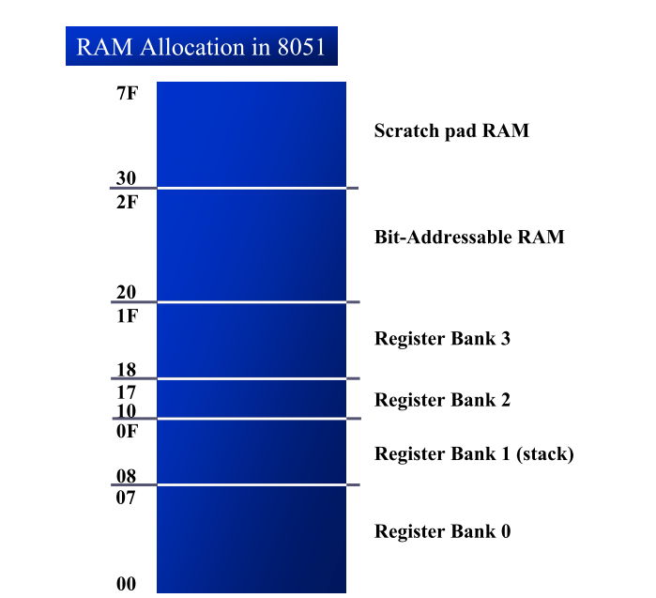
8051 REGISTER BANKS AND STACK RAM Memory Space Allocation (cont’)

Slide 35
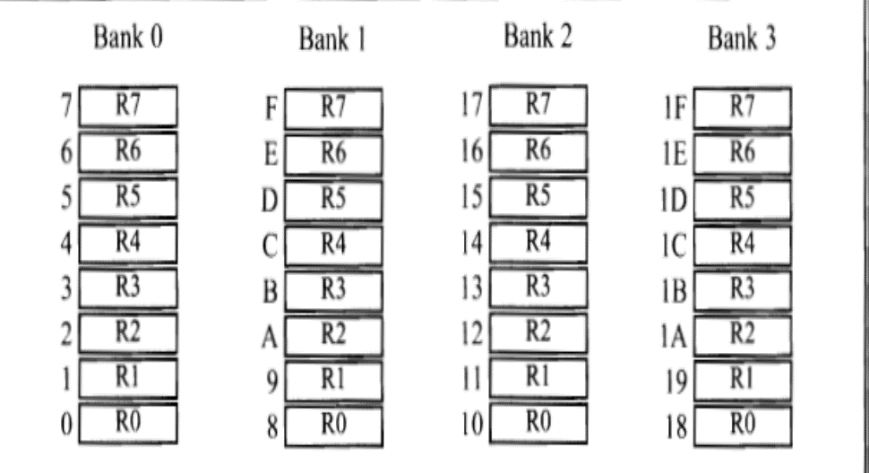
8051 REGISTER BANKS
These 32 bytes are divided into 4 banks of registers in which each bank has 8 registers, R0-R7
RAM location from 0 to 7 are set aside for bank 0 of R0-R7 where R0 is RAM location 0, R1 is RAM location 1, R2 is RAM location 2, and so on, until memory location 7 which belongs to R7 of bank 0
It is much easier to refer to these RAM locations with names such as R0, R1, and so on, than by their memory locations
Register bank 0 is the default when 8051 is powered up

Slide 36
Register Banks and their RAM addresses
Register bank 0 is the default , when MC is powered ON

Slide 37
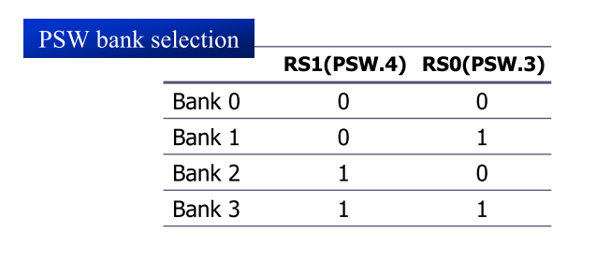
8051 REGISTER BANKS
We can switch to other banks by use of the PSW register
Bits D4 and D3 of the PSW are used to select the desired register bank
Use the bit-addressable instructions SETB and CLR to access PSW.4 and PSW.3

Slide 38
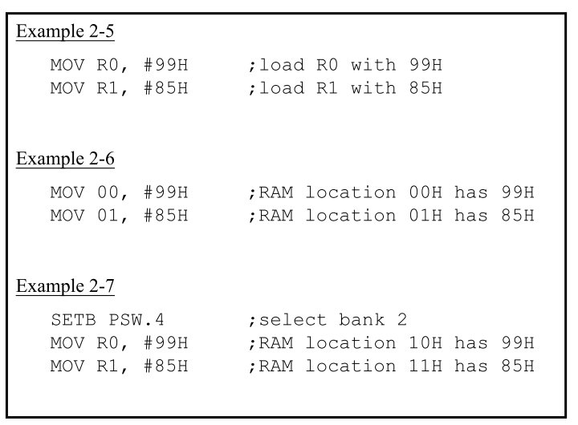
8051 REGISTER BANKS

Slide 39
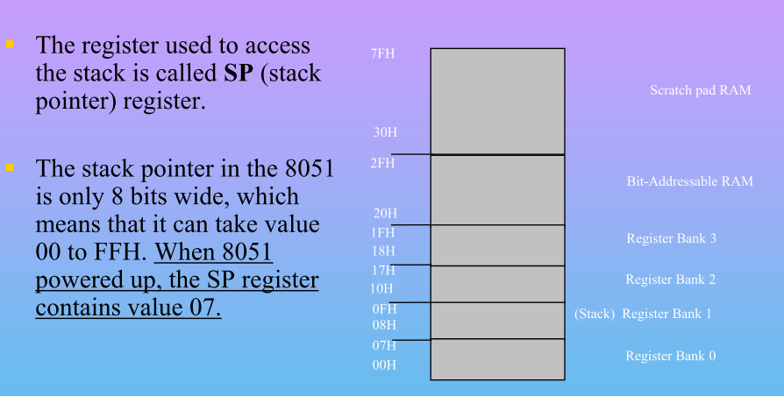
Stack in the 8051
The stack pointer in the 8051 is only 8 bit wide, which means that it can take value of 00 to FFH
When the 8051 is powered up, the SP register contains value 07
RAM location 08 is the first location used for the stack by the 8051
Make sure that the stack is growing toward RAM location 7FH, from lower to upper addresses (for PUSH)
When 8051 is powered up, register bank 1 and the stack are using the same memory space
We can reallocate another section of RAM to the stack

Slide 40
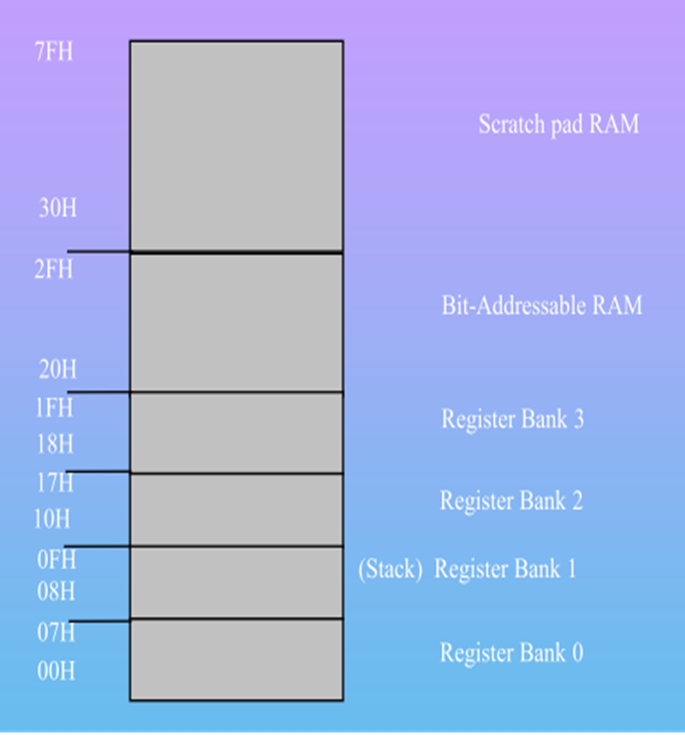
To PUSH the register contents on to the stack, we must use their memory addresses
PUSH 2 ( Pushes the R2 contents into the stack)
Similarly POP 5
(Pops the stack contents to mem location 5 a.k.a R5)
Stack pointer is 8 bits wide( can take values from 00h to 7Fh)
When powered on SP is initialized to 07H

Slide 41
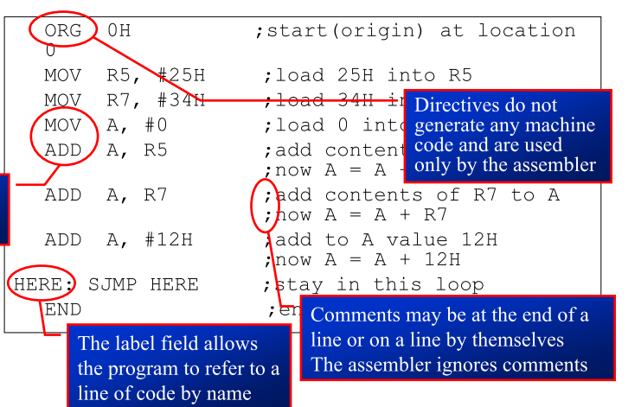

8051 ASSEMBLY PROGRAMMING Structure of Assembly Language
An Assembly language instruction consists of four fields:
[label:] Mnemonic [operands] [;comment]

Slide 42
8051 ASSEMBLY PROGRAMMING ASSEMBLING AND RUNNING AN 8051 PROGRAM
The step of Assembly language program are outlines as follows:
1. First we use an editor to type a program, to create and/or edit the program (The editor must be able to produce an ASCII file
The source file has the extension “asm“ or “src”, depending on which assembly used
2. The “asm” source file containing the program code is fed to an 8051 assembler
The assembler will produce an object file(.obj)and a list file(.lst)

Slide 43
8051 ASSEMBLY PROGRAMMING ASSEMBLING AND RUNNING AN 8051 PROGRAM
The step of Assembly language program are outlines as follows:
3.Assembler require linking which takes one or more object code files and produce an absolute object file with the extension “abs”
This abs file is used by 8051 trainers that have a monitor program
4. Next the “abs” file is fed into a program called “OH” (object to hex converter) which creates a file with extension “hex” that is ready to burn into ROM
This program comes with all 8051 assemblers
Recent Windows-based assemblers combine step 2 through 4 into one step

Slide 44
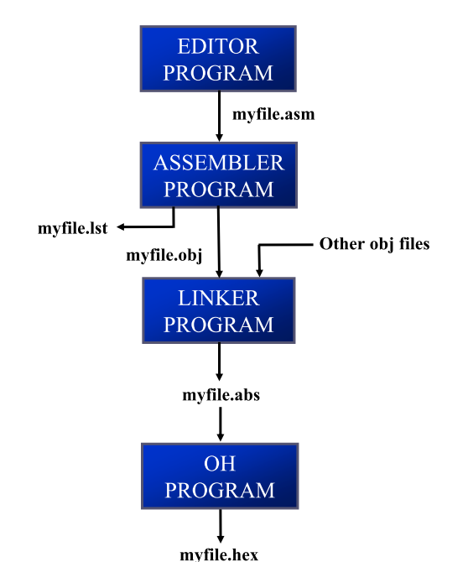
ASSEMBLING AND RUNNING AN 8051 PROGRAM Steps to Create a Program

Slide 45
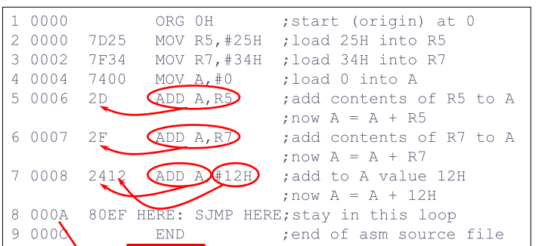

ASSEMBLING AND RUNNING AN 8051 PROGRAM lst File
The lst (list) file, which is optional, is very useful to the programmer
It lists all the opcodes and addresses as well as errors that the assembler detected
The programmer uses the lst file to find the syntax errors or debug

Slide 46
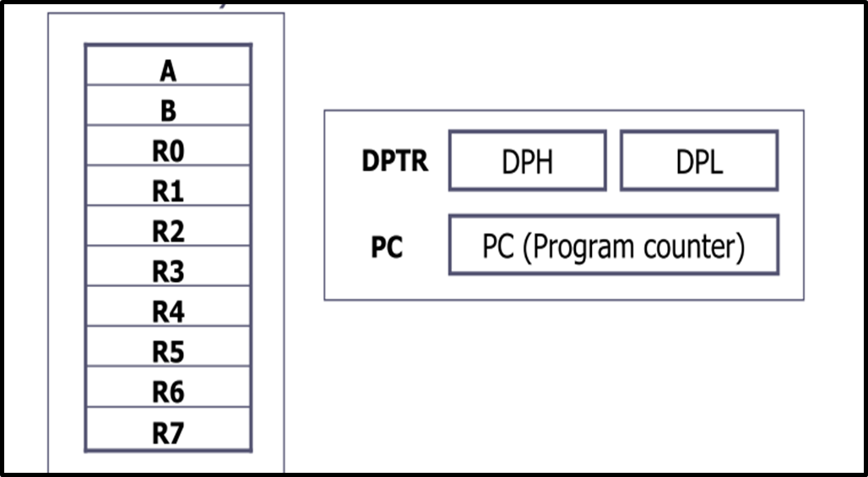
PROGRAM COUNTER AND ROM SPACE Program Counter
The program counter points to the address of the next instruction to be executed
The program counter is 16 bits wide
This means that it can access program addresses 0000 to FFFFH, a total of 64K bytes of code
All 8051 members start at memory address 0000 when they’re powered up
Program Counter has the value of 0000
The first opcode is burned into ROM address 0000H, since this is where the 8051 looks for the first instruction when it is booted

Slide 47
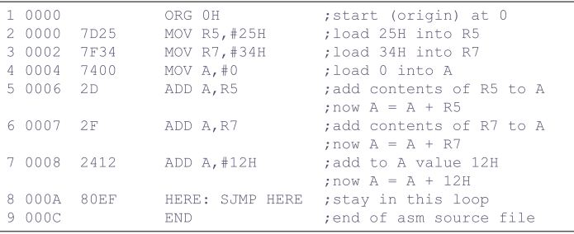
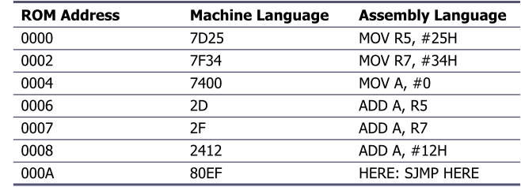
PROGRAM COUNTER AND ROM SPACE Placing Code in ROM
Examine the list file and how the code is placed in ROM

Slide 48
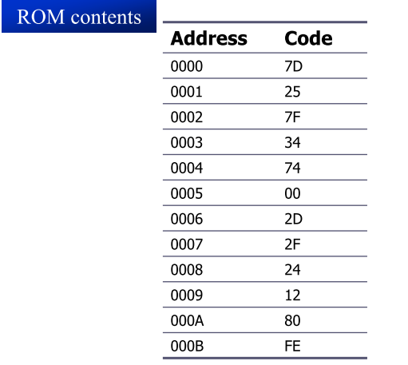
PROGRAM COUNTER AND ROM SPACE Placing Code in ROM (cont’)
After the program is burned into ROM, the opcode and operand are placed in ROM memory location starting at 0000

